Slide 1

Digital Library as Network and Community Center
A Successful Model for Contribution and Use

Slide 2
Workshop Outline
Introductions/Review Handouts
HARDWARE AND SYSTEM SUPPORT
Digitization devices:
Storage devices:
Define/Plan/Write Project Application
Network Attached Storage (NAS):
CONCLUSION
Storage Area Networks (SAN): A
e-Library file server:
Client side hardware:
Computing hardware requirements:
ADVANTAGES

Slide 3

INTRODUCTION
Building a digital library involves several functional issues. Digital library with current electronic collections or digital archive with preservation purpose has to take into consideration basic issues like users, content issues, IPR issues, technical issues etc. The technical issues are the focus point of this Unit.
Digital library requires several infrastructural facilities. There is no single package of hardware and software for digital libraries. The LIS professional has to understand various components of hardware and software requirements, identify vendors, check their suitability to library environment, procure and integrate them as single unit library. The ever changing processor designs in computing there is exponential increase in processing speed. The improvements in storage technology made the development and maintenance of digital libraries economical. The internal memory is now measured in tera, peta and exa bytes. Similarly external memory also made great strides. CDs, DVDs Extended memory cards with improved disc drive reliability provide the facility for external storage of huge digital collections.

Slide 4
Major Activities
Developing and maintaining digital library infrastructure – hardware, software, staff expertise
Creation of digital resources for instruction (Variations and DIDO)
Creation of digital resources for research (archival collections, indexes)
Consultation with individuals and department who have ideas about potential digital projects

Slide 5

Definition of Digital Library
A digital library is a networked collection of digital objects – text, still images, moving images, sound, data – with arrangement, search features, and metadata that allow for discovery and presentation, supporting research and teaching, and with attention paid to architecture, persistence, longevity, and digital preservation.

Slide 6
DIGITAL LIBRARY ACT
Digital libraries are hampered by copyright law because, unlike with traditional printed works, the laws of digital copyright are still being formed. The republication of material on the web by libraries may require permission from rights holders, and there is a conflict of interest between libraries and the publishers who may wish to create online versions of their acquired content for commercial purposes. In 2010, it was estimated that twenty-three percent of books in existence were created before 1923 and thus out of copyright. Of those printed after this date, only five percent were still in print as of 2010. Thus, approximately seventy-two percent of books were not available to the public.^{[38]}
There is a dilution of responsibility that occurs as a result of the distributed nature of digital resources. Complex intellectual property matters may become involved since digital material is not always owned by a library.^{[39]} The content is, in many cases, public domain or self-generated content only. Some digital libraries, such as Project Gutenberg, work to digitize out-of-copyright works and make them freely available to the public. An estimate of the number of distinct books still existent in library catalogues from 2000 BC to 1960, has been made.^{[40][41]}
The Fair Use Provisions (17 USC § 107) under the Copyright Act of 1976 provide specific guidelines under which circumstances libraries are allowed to copy digital resources. Four factors that constitute fair use are "Purpose of the use, Nature of the work, Amount or substantiality used and Market impact."^{[42]}
Some digital libraries acquire a license to lend their resources. This may involve the restriction of lending out only one copy at a time for each license, and applying a system of digital rights management for this purpose (see also above).

Slide 7
What is a Digital Library Project?
Digital conversion for the purpose of online access to an information resource
Creation of metadata for future digital conversion
Tools for creating online resources
It is not only creating a web site.
It is not only scanning to place photographs or other images on your web site.
The goal to create and sustain “good” digital collections

Slide 8
.HARDWARE AND SYSTEM SUPPORT
Hardware is a general term for the physical artifacts of a technology. The technological developments both computing and networking gave birth to the development of digital libraries. The digital libraries basically depend on hardware and software that puts the operations to roll on. There are standard and efficient hardware technologies available for the development and maintenance of DLs. The following paragraphs explain the basic hardware requirements for computing, digitization and server support for platform and web.

Slide 9

Digitization devices:
Most of the digital repository collections are converted digital documents. The library has to maintain the digitization devices / tools to convert the analogue document into digital format and preserve the same.
Three hardware technologies
Scanners – Flat bedded, drum etc.
Sheet feeders
Microfilm Scanners
Digital Camera.

Slide 10
Scanners:
Scanners: A Scanner is a peripheral device that optically scans images, printed text, handwritings, or an object, and converts it to a digital image. Scanners typically connect via Universal Serial Bus (USB) and then software provided by the manufacturer or the operating system to scan documents, photos or other items to the computer for printing, manipulation etc. The important issues to be considered with regard to scanners are • Capability of scanner to be suitable to the material to be scanned
Scanners have to produce requisite quality of material
Both scanners and camera use Charge Coupled Device (CCD) as their core component
CCD is a tiny light sensitive diode that sweep across an image while capturing and when exposed to light generate series of digital signals that are converted into pixels
Important factor is the resolutions the scanner is capable that are measured in dpi (dots per inch). Image: Image is the output of the scanner. The technical details of the image are
Image quality o Resolution – The number of pixels used to display an image are expressed in dpi (dots per inch). Lowering the resolution will blur the image quality. o Bit depth or dynamic range has its effect on the level of colour that will be captured.

Slide 11
Digital Cameras:
The primary component of digital cameras is sensors made out of silicon. A digital camera takes light and focuses it via the lens onto a sensor. The sensors are a grid of tiny photosites that are sensitive to light. Each photosite is usually called a pixel and millions of these individual pixels are there in the sensor of a digital camera or otherwise known as singlelens reflex camera (DSLR). There are high level DSLRs with extreme sharpness, excellent image quality, high density and fast image processing with anti-flicker and crop shooting features. HDSLR is a DSLR camera with the capability for HD video recording

Slide 12
. Storage devices:
The primary objective of digital library is storage of digital collections ensuring long term preservations and to provide continued access to the same. Hence a digital library requires huge storage space with multiple hard disks. A typical digital library in distributed client server environment consists of hardware and software at client as well as server side. Server hosts databases, digital objects and search interfaces. Clients are the machines that are used for accessing DL by users. So a server is the heat of the digital library. It should have-
Adequate memory
Large space for data / file storage
Good communication capabilities 8
Scalability for additional storage and processing

Slide 13
Backup and storage server
Storage of extremely large collections on DVDs etc is difficult and it is prone to get damage. Therefore for long term preservation and for providing continued access to digital files back up servers are being used. In computing, a file server is a computer attached to a network that has the primary purpose of providing a location for shared disk access, i.e. shared storage of computer files (such as documents, sound files, photographs, movies, images, databases, etc.) that can be accessed by the workstations that are attached to the same computer network. The term server highlights the role of the machine in the client– server scheme, where the clients are the workstations using the storage. A file server is not intended to perform computational tasks, and does not run programs on behalf of its clients. It is designed primarily to enable the storage and retrieval of data while the computation is carried out by the workstations. (Wikipedia). Ex campus networks that use a LAN to connect their client computers. A file server may be dedicated or non-dedicated. A dedicated server is designed specifically for use as a file server, with workstations attached for reading and writing files and databases. Since the crucial function of a file server is storage, technology has been developed to operate multiple disk drives together as a team, forming a disk array.

Slide 14
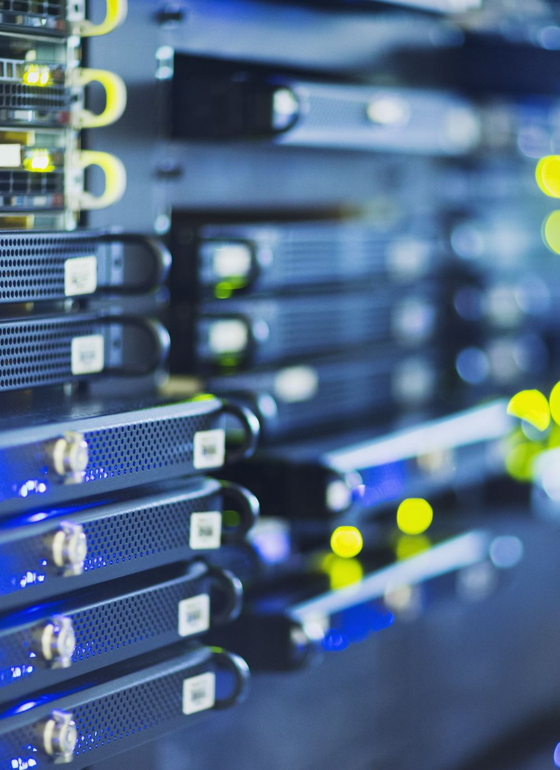
Network Attached Storage (NAS): N
NAS system consists of a dedicated data storage unit connected directly to a computer network which provides centralized data access and storage facilities to the network clients. It is like any other PC or a server, but stores only files which can be shared by any network member. The server comes with pre-installed operating system and a file management system (FMS). In a NAS system, the operating system usually will be residing on a separate hard disk, with or without mirroring or on a chip that comes along with the mother board. Generally NAS uses two types of storage technologies.

Slide 15
Storage Area Networks (SAN):
A storage area network (SAN) is a network designed to attach computer storage devices such as disk array controllers and tape libraries to servers. A SAN allows a machine to connect to remote targets such as disks and tape drives on a network. SAN 10 support disk mirroring, backup and restore, archival and retrieval of archived data, data migration from one storage device to another, and the sharing of data among different servers in a network. SANs can incorporate sub-networks with network-attached storage (NAS) systems. Examples of servers available in the market: •
Sun: Sun StorEdge 5210 NAS and Sun StorEdge 5310 NAS
HP: HP has six storage servers available, including the ProLiant DL100 G2 storage server
Dell: PowerVault 745N qualifies as a storage server
Network Appliance: Offers a range of NAS products, including the FAS200 Series
Aberdeen, Inc.: several storage servers
Microsoft: Microsoft Storage Server 2003
A small library may work with single server but a large DL requires specialized servers for different task by distributing work load on different servers

Slide 16
e-Library file server:
The library subscribes to e-documents like e-journals either independently or through consortia. Such electronic collections have to be maintained on a separate server and cannot be merged with institutional repository for administrative reasons. All such digital acquisitions have to be hosted on a separate server and made accessible to users.

Slide 17
Client side hardware:
In a networked environment, client is often a Web browser running on a computer that connects the end user to the network server. Obviously, computers with more memory, hard drive space, and processors tend to make better servers. The clients have to be provided with devices like PCs, laptops, tablets, mobile devices to get access. The device should meet certain technical requirements -client side operating system (Windows or Mac), client side browser (Internet Explorer, Google Chrome, Safari).

Slide 18
Computing hardware requirements
The following is a suggestive list of minimum computing hardware requirement
Computer: Pentium 4, Clock Speed 3.0 Ghz;
1 MB L2 Cache; 800 MHz FSB
512 MB PC 2700 ECC DDR RAM
2X36 GB ULTRA 320 SCSI HDD (OR) 3X80 GB Serial ATA HDD
2X 10/100 Mbps LAN Card
DVD – RW
Advance Graphic cards; integrated audio
Serial and Parallel I/O Ports
LINUX (OR Windows) Operating system
Printer: HP Laser jet
UPS

Slide 19
Most important point
Make sure that there is a good match between the components of the project plan you developed and the LSTA categories of funding, priorities, and evaluation criteria.
You may have an excellent idea for a digital project, but be sure that it fits the requirements for LSTA funding.

Slide 20
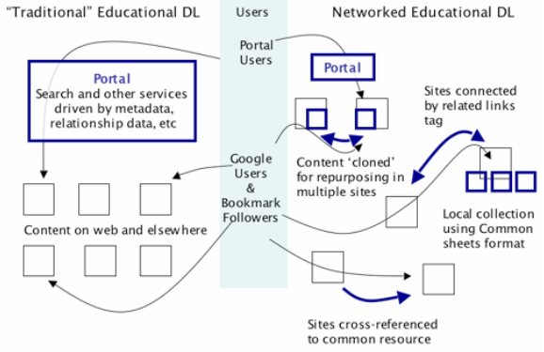
Fig 1.
Bold blue boxes and arrows represent areas where DL value is added as users navigate to content (thin black boxes). In the traditional educational DL, only users who actively decide to use the DL portal benefit. In the networked model, much of he DL value is integrated into the content and presentation of the sites themselves, and so impacts a wider range of users.

Slide 21
The Value Proposition
A successful educational digital library is as much a social process as a technical problem. It requires creation of a culture that fosters contribution to and use of the library (5, 8, 9, 11). We have addressed creation of this culture by working with NSF-funded projects focused on the professional development of geoscience faculty as teachers. Each of these projects partnered with SERC to create its project website. They seek two primary services in this partnership: 1) tools, resources and experts that assist them in creating high quality project websites and 2) placement of their resources in a network that enhances dissemination and use of their work. We created a win-win situation that yields rapid production of content for the library and facilitates use, by allowing our partners the flexibility to meet their own project goals while contributing to the overarching digital library.

Slide 22
CHALLENGES
This approach carries with it some major challenges. Bringing together the work of individual projects, each with its own leadership, goals, identity and passions, requires flexibility. It is more difficult to impose uniform standards, to require review using a specific process, or to mandate the breadth of library holdings. Creating an integrated network from these resources requires knowledge of the breadth of resources and the breadth of user communities. To date, we have worked within a community we know well,
Below we describe our work in implementing this community DL model through a set of services that enabled geoscience education projects to collectively build the Teach the Earth educational digital library.

Slide 23
advantages:
The common format allows users to efficiently scan through a large collection of resources after gaining some initial familiarity with the standard structure. This benefit multiplies as a format is adopted by multiple collections and projects.
The particular choice of required fields in each template has evolved from experience to include the information users find most valuable and to reflect educational best practice. As authors put their materials online via a sheet format, they are guided by the format itself toward reaping the benefits of insights into user needs gained by other projects and from educational research. For example, ActivitySheets and CourseSheets both emphasize goal setting, an important part of the educational design process (31).
Sheets link the information needed for use of a resource to the resource itself, acting as a vehicle for sharing individual experiences with the larger community and supporting educational reuse (32, 33, 11).
Sheets serve as a natural locus around which to link data, activities, references, and other information relevant to the use of a specific resource. They facilitate the creation of resource-centric, rather than metadata-centric, collections (6).

Slide 24
Digital Library Tools Promoting Reuse and Referencing
Contributors have access to a full collection of metadata records describing websites and print references that have been contributed by previous projects (including the full Digital Library for Earth System Education catalog). These records can be selected and organized using either of two tools: a resource list tool and a faceted search tool
The catalog record for each resource displays the location of references to it across the library (26).
Contributors can incorporate modules of material created by other projects directly in their project. The information in the module is 'wrapped' with the look and feel of their website and then embedded within that site with conventional links.
A related links tool enables contributors to make connections between their work and related work in other projects. This tool can be used to make associations between pages at any level of the website.

Slide 25
library design in supporting users in information seeking behavior:
Existing user search behavior that uses Google as a touchstone is supported. The DL community continues to discuss whether DL's can offer better alternatives to commercial internet search engines such as Google (45). A resource web acknowledges the powerful and popular role that Google and other commercial search engines play in discovering resources and creates strategies that capitalize on this behavior.
The resource network enables exploratory searching and supports finding resources more than once. Users can explore the site using a variety of navigation elements:
The primary challenge of this design is ensuring that users are not overwhelmed or confused. In particular, users note that they have a sense that they cannot comprehend the full scope
The typical limits of users' search behavior are circumvented, leading to increased exploration on the site. When using discovery interfaces that present resources as a list of isolated, decontextualized search returns,

Slide 26
Conclusion
Teach the Earth evolved as a digital library from the collective work of a number of NSF-funded projects focused on professional development in geoscience education. While the resulting library has features that are typical of a digital library (a metadata repository that supports a centralized portal with search and browse capacity) its unique history led to a focus on authoring tools, tools that support reuse and sharing, and a networked structure that promotes the work of individual projects while integrating them into a larger whole.
This structure has been advantageous in building a value proposition for contributors who gain valued services through their participation in the library and for users who can find the integrated resources of leaders in geoscience education in ways that effectively integrate with their use of commercial search engines. As a result, Teach the Earth is sought out as a partner by new projects for the services it provides, and it is used by a significant fraction of the target community (geoscience faculty). While challenges of scalability will face the library as it matures, it provides an example of the ways in which a digital library can create an intellectual commons that is a central part of the work of an educational community.

